Slide 1


On THE MOVE IN EUROPE –TOWARDS A DEMOCRATIC, MULTICULTURAL EUROPE
Realized by Rusu Maria-Laura
Gavriz Elena-Diana
Onete Delia
Sibana Leonard

Slide 2
What does democracy mean?
Democracy means that the citizens have the power to choose their president by vote in elections. It`s a system of government ruled by a whole population or all eligible members of the state

Slide 3
What is democracy all about?
In a democracy, every citizen has certain basic rights that the state cannot take away from them. These rights are internationally recognized and guaranteed. Everyone has the right to have their own beliefs, including their religious beliefs, and to say and write what they think. Everyone has the right to seek different sources of information and ideas.

Slide 4
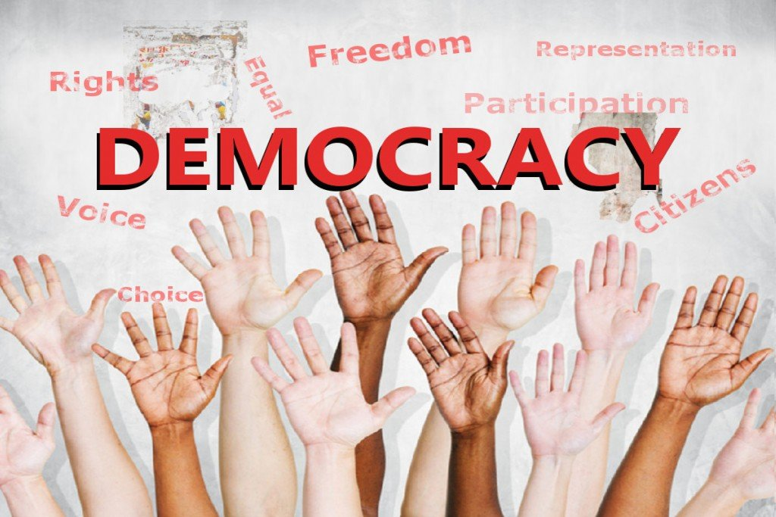

Slide 5
Values of Democracy-What can we do?
RESPECT AND TOLERANCE:
Promote respect for individual differences
Organise visits to places of worship
Develop links with faith communities
Challenge prejudicial or discriminatory behaviour
Help pupils to acquire an understanding of, and respect for, their own and other cultures and ways of life

Slide 6
Individual Liberty- What can we do?
Follow the UNICEF rights respecting school agenda
Implement a strong anti-bullying culture
Challenge stereotypes
Encourage pupils to take responsibility for their behaviour, as well as knowing their rights
Support individuals to develop their self-esteem, self-knowledge and self-confidence

Slide 7
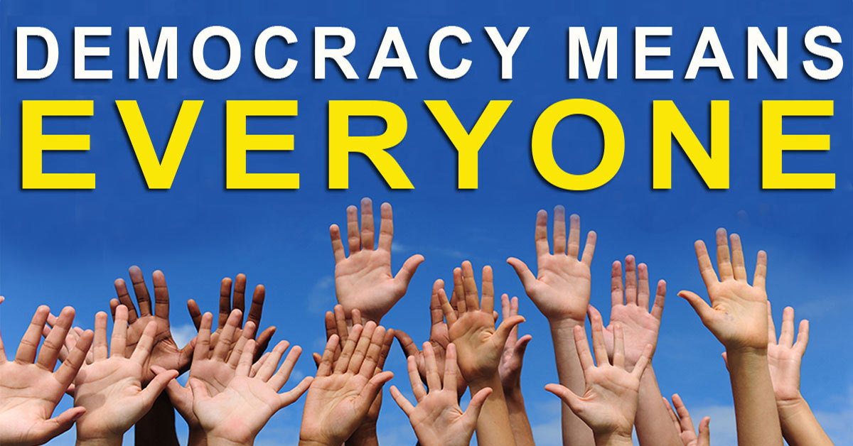

Slide 8
Democracy in EU
Democracy and integration are the fundamental principles on which the EU is built. After the fall of communism, many ex-socialist states requested to join the Union and adjust to a market economy. Despite the fact that many Eastern-European states had widely underdeveloped economies, by 1997, the EU had agreed that the economic and political situation in countries such as the Czech Republic, Poland, Estonia were favorable enough that they could join after 2000.

Slide 9
What factors are a threat to democracy?
Populism presents a big threat to democratic principles, It usually manifests as a sharp distinction between friend and enemy. With supporters portrayed as “legitimate” and opponents as “illegitimate”. Parties and demagogic politicians go further than simply denouncing what they perceive to be justice and corruption- they claim to represent “the people” against elites, immigrants or some minority, which encourages political ignorance or acting based on systemic biases.

Slide 10
The Media
Another aspect that poses a threat to democracy is a dishonest media. Many publications and news channels spread inaccurately represented information and cover talking points the cause people to distrust certain politicians or other influential people, and lead to discussions which drive people to adopt certain political points that may not be true to their intentions, but rather.

Slide 11
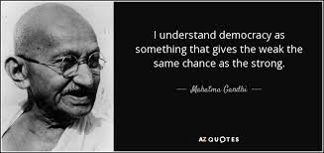

Slide 12
Conclusion
Democracy can take many forms, but the core elements are always present- fair elections, active participation of the people, protection of human rights and rule of law.

Slide 13
THANK YOU FOR WATCHING

